Slide 1
PEER-TO-PEER BOOK RENTAL SERVICE

Slide 2
ABSTRACT
The project aims to provide an effective, feasible and intuitive online portal that facilitates the readers to read the books and magazines on a reliable rent scheme.
Users can make the books they own available for rent.
Other users can borrow the book that are available for rent securely.
The books can be securely returned to the lender after the borrow duration expires.
User’s session data is protected from adversaries using encryption.

Slide 3
INTRODUCTION
The convenience of an online book rental is a major consideration for most of us, especially those living in areas where access to a large bookstore is limited or is quite far away.
Many books are too much expensive and for these types of books, this system is most preferable. If a book is too expensive, then one can rent that Book for some amount and can read that book by spending a very small amount of money.
After reading the whole book they can return a book and another one can take Benefit of this type of expensive books.
Using our website both renter and borrower will be benefitted.

Slide 4
PROPOSED METHODOLOGY
The user has to login into their account. If they do not have an account, then the user has to sign up to the portal. After signing up, the user is redirected to the sign-in page where the user credentials are verified.
If the user chooses to check the rental system, he will be redirected to another page that is composed of two components, the book rental system, and the history of previously rented books. In the book rental system, there will be a form in which details of the book which the user wants to give away for rent will be submitted and the book will be made available in the borrow section of the application.
On the borrower section, the user can send a borrow request to the vendor of the book and browse through all the books which are up for borrowing.
On the book return section, users can see the list of all the books he/she had ever borrowed from the portal along with the option to return the books he currently has not returned to its owner. The user can also manually sign out.

Slide 5
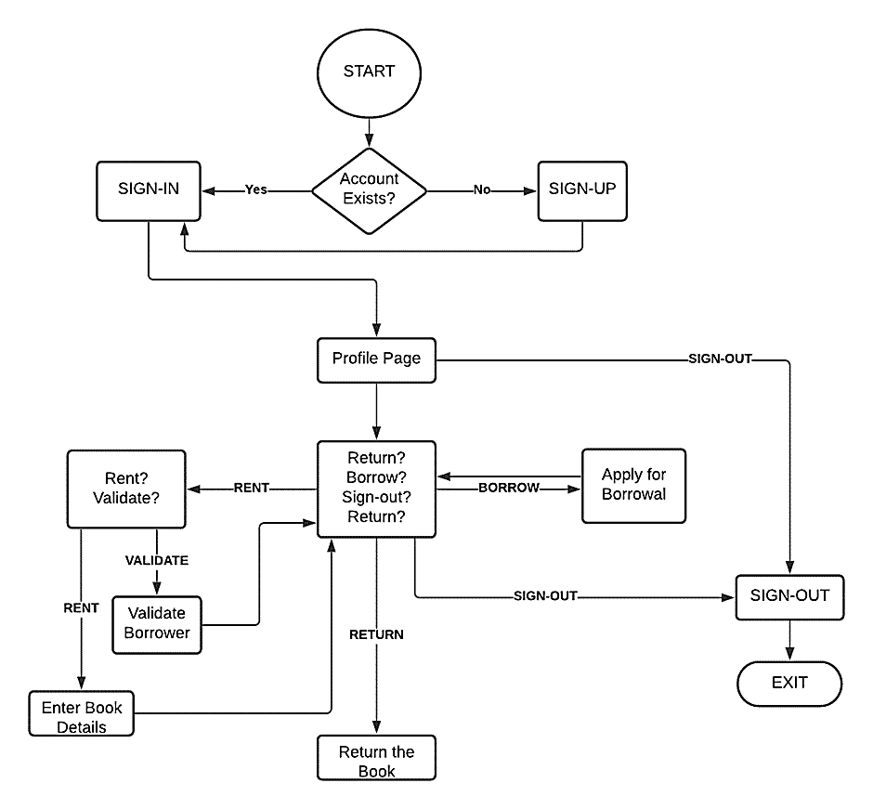
FLOW CHART

Slide 6
PROCESS MODEL (INCREMENTAL MODEL)
We have picked the incremental process model for our project because our project is modular in the sense that each module of our project can be developed independently with only the routes to be established to integrate a module into our project.
Database model creation
Sign-in, Sign-up, Sign-out
User Profile management
Book rental system
Book borrower system
Book return system

Slide 7
RISK ANALYSIS
Sr. No. | Risk | Effects | Solution
1. | Customer fails to understand the impact of requirement changes | Tolerable | Notifying user of the adversaries caused by not changing the requirements can help. The quality of the end product is enough to convince the user that requirement change was justified.
2. | Software components to be used does not cater the requirements of the project. | Serious | Switching to other software compatible to the requirements of the project can help but delay the development of the product.
3. | Module integration failure | Serious | Debugging, checking and satisfying integration constraints across the modules is first stage of solving the risk. Module reconstruction is not advised as it will massively delay the product development and should only be considered as an option in dire situations.
4. | Time required for development of project underestimated | Serious | Overtime from the members concerned with the project is only immediate solution to the risk without any shift in deadlines.
5. | Database inconsistencies and compatibility issues | Serious | Alternative database solutions will have to be incorporated.
6. | Garbage data collection | Tolerable | Cleaning and filtering techniques must be implemented on server and client-side of the application before pushing data into database and sending data to the server from client-side to increase storage efficiency and processing efficiency.

Slide 8
FUNCTIONAL REQUIREMENTS
Session Management: This includes Sign-in, Sign-out and Sign-up features for user’s session creation and management. It is a high priority task because it ensures the security of the users.
Profile Management: This feature enables logged-in users to view and modify their profile personal information. The users can also visit other users’ profile to see their public details but can’t modify other’s details. Profile page is the first page the user is redirected to after successfully signing in. It helps the users to keep track of who borrowed or rented the book and can help leverage reliability of certain vendors and borrowers.
Book Exchange Management: The feature enables logged-in users to rent, borrow or return books.
If the user chooses the rent a book, there will be a form in which the details of the book which the user wants to give away for rent will be submitted and the book will be made available in the borrow section of the application.
If the users choose to borrow a book, the user can send a borrow request to the vendor of the book and browse through all the books which are up for borrowing.
If the user wants to return the books (which the user borrowed), user users can see the list of all the books he/she had ever borrowed from the portal along with the option to return the books he currently has not returned to its owner.

Slide 9
NON-FUNCTIONAL REQUIREMENTS
Performance Requirements: User Sessions must be maintained to reduce inconvenience of signing in every time they visit the website for the user to maintain a proper work flow for active users.
Safety Requirements: Transactions must be safely completed to reduce risk of frauds. The session information should be properly encrypted to safeguard the identity of the user. The cookies must be set to expire periodically too to ensure proper authentication of the user periodically.
Software Quality Attributes: The application must be robust and assume that wrong entries can be entered by user and the application therefore should not crash when inappropriate details were entered instead of letting them pass through. The data in database should be maintained and cleaned.
Business Rules: Admins can manipulate transaction in dire situations to avoid well thought out frauds.
Confirmation from the client side will still be required to make changes to user’s database.
Admins also have control to block certain users if they violate a lot of policies of the application or add nsfw content.

Slide 10
CHALLENGES
• Book faltering: The difficulties encountered during the process of renting books are difficult to address, for example, if the book is ripped, it causes a complication for both the lender and the borrower.
• Malicious Renter: The lender might attempt to defraud the customer by charging an additional fee after the deal’s done or by scamming the customer by not authenticating the end of book subscription, therefore, locking the customer into an endless rent cycle.
• Malicious Borrower: The borrower didn't return the books, or he/she wanted to concoct a scheme to avoid paying the late fee and fine.

Slide 11
GANTT CHART
Project Module | Module Stage | Initiation Date (2021) | Completion Date (2021)
Database Model Creation | Requirement Analysis | 18th August | 20th August
 | System Design | 21st August | 22nd August
 | Implementation | 23rd August | 25th August
 | Testing | 26th August | 27th August
 | Deployment | 28th August | 28th August
 | Maintenance | 29th August | --- --- --- --- --- ---
Sign-in, Sign-up, Sign-out | Requirement Analysis | 30th August | 1st September
 | System Design | 2nd September | 4th September
 | Implementation | 5th September | 12th September
 | Testing | 13th September | 14th September
 | Deployment | 15th September | 15th September
 | Maintenance | 16th September | --- --- --- --- --- ---
User-Profile Management | Requirement Analysis | 17th September | 17th September
 | System Design | 18th September | 18th September
 | Implementation | 19th September | 22nd September
 | Testing | 23rd September | 23rd September
 | Deployment | 24th September | 24th September
 | Maintenance | 25th September | --- --- --- --- --- ---
Book Rental System | Requirement Analysis | 26th September | 28th September
 | System Design | 29th September | 1st October
 | Implementation | 2nd October | 2nd November
 | Testing | 3rd November | 13th November
 | Deployment | 14th November | 20th November
 | Maintenance | 21th November | --- --- --- --- --- ---
Book Borrower System | Requirement Analysis | 26th September | 28th September
 | System Design | 29th September | 1st October
 | Implementation | 2nd October | 2nd November
 | Testing | 3rd November | 13th November
 | Deployment | 14th November | 20th November
 | Maintenance | 21th November | --- --- --- --- --- ---
Book Return System | Requirement Analysis | 26th September | 28th September
 | System Design | 29th September | 1st October
 | Implementation | 2nd October | 2nd November
 | Testing | 3rd November | 13th November
 | Deployment | 14th November | 20th November
 | Maintenance | 21th November | --- --- --- --- --- ---

Slide 12
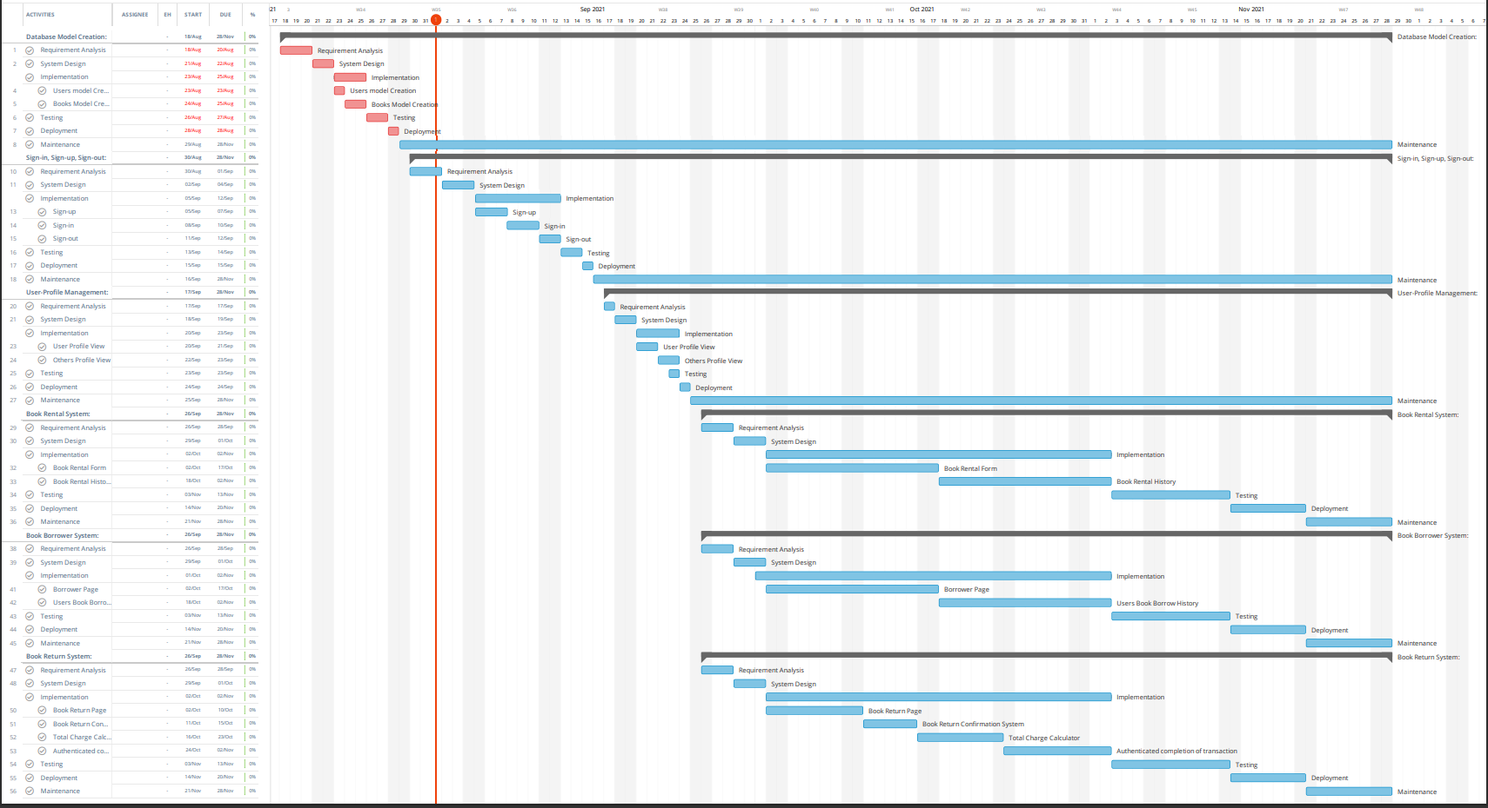

Slide 13
WORK BREAKDOWN STRUCTURE

Slide 14
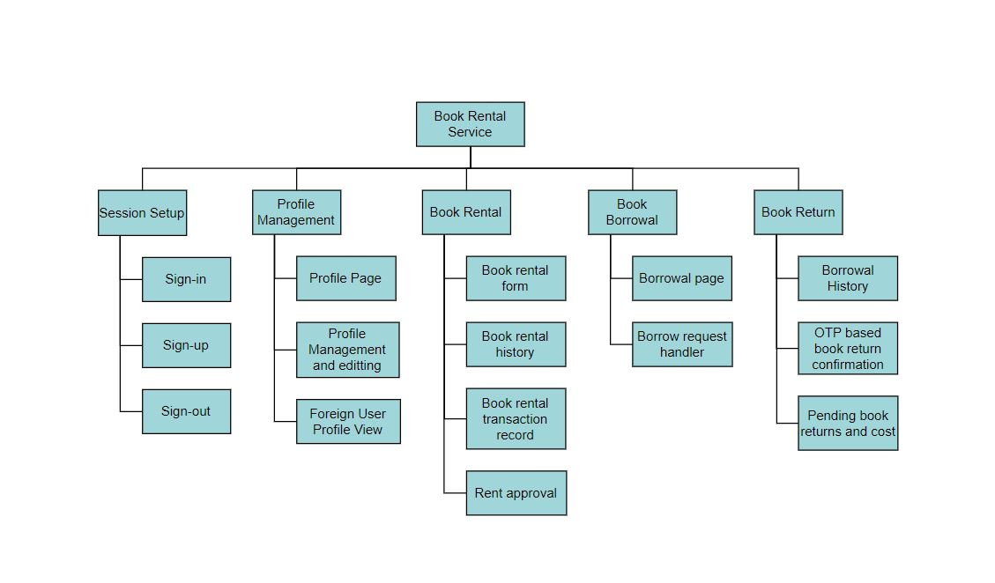
DELIVERABLE-BASED WBS

Slide 15
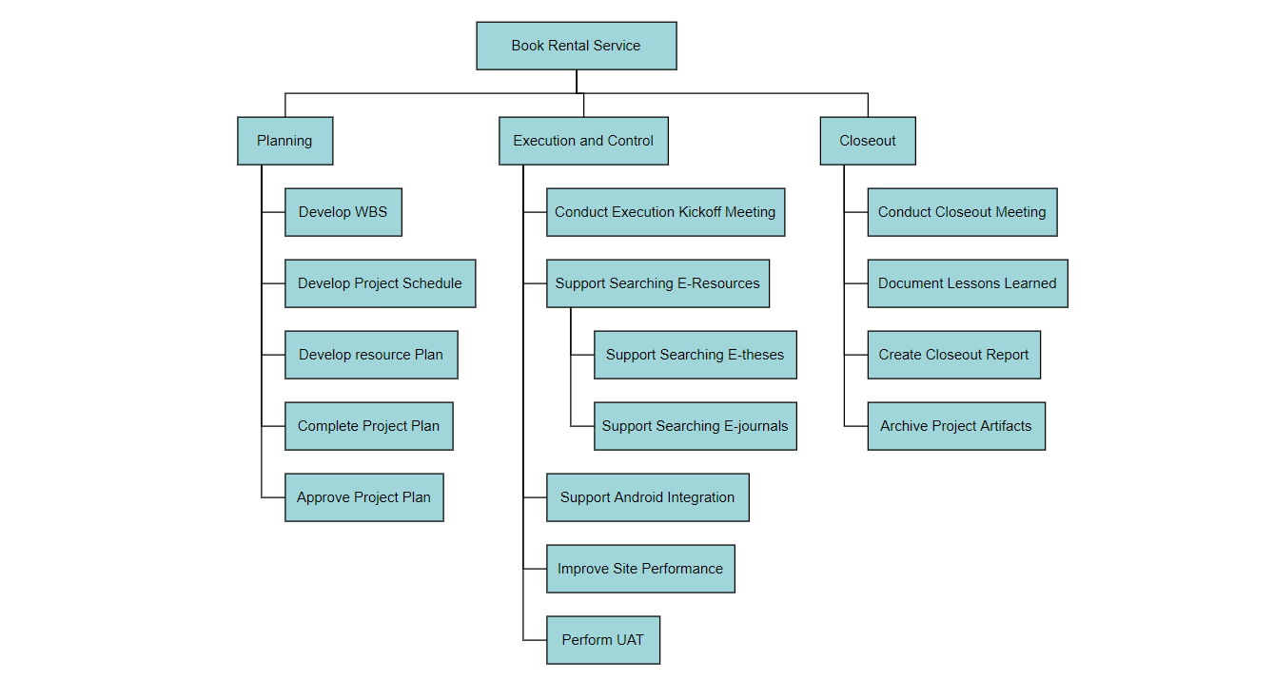
PHASE-BASED WBS

Slide 16
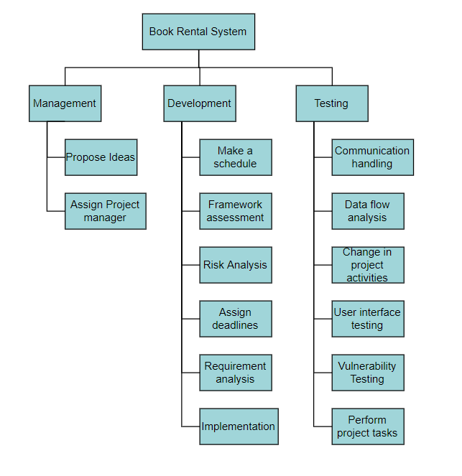
RESPONSIBILITY-BASED WBS

Slide 17
UML DIAGRAMS

Slide 18
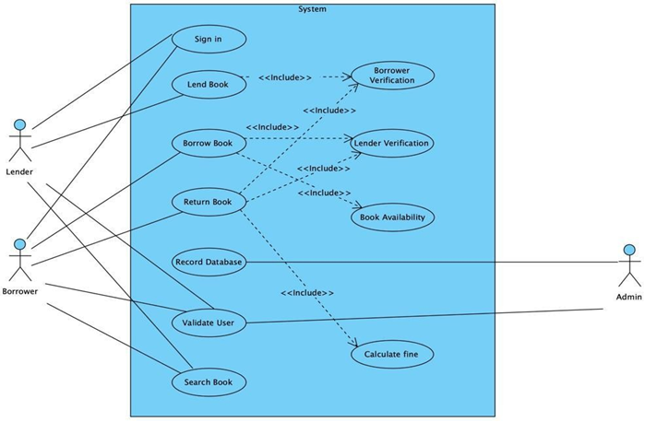
USE-CASE DIAGRAM

Slide 19
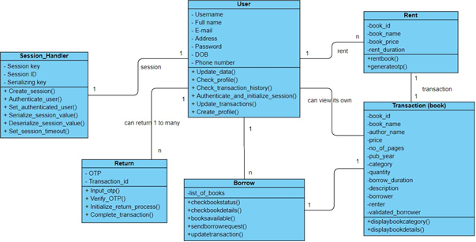
CLASS DIAGRAM

Slide 20
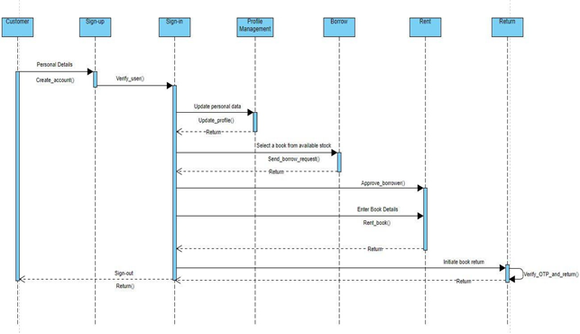
SEQUENCE DIAGRAM

Slide 21
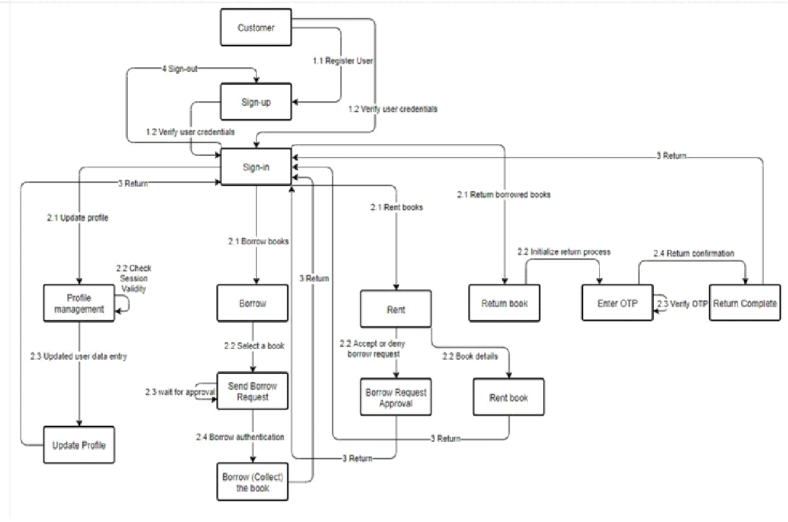
COLLABORATION DIAGRAM

Slide 22
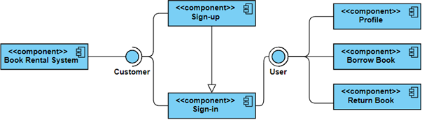
COMPONENT DIAGRAM

Slide 23
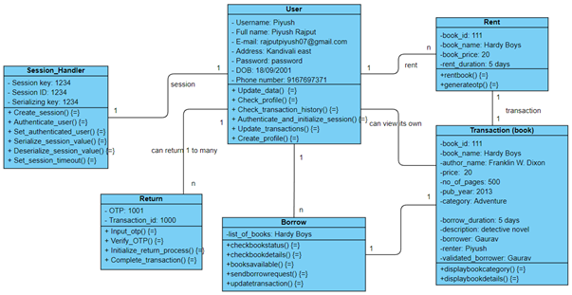
OBJECT DIAGRAM

Slide 24
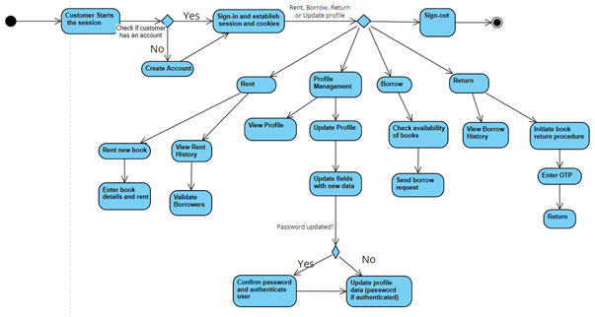
ACTIVITY DIAGRAM

Slide 25
WIREFRAME

Slide 26
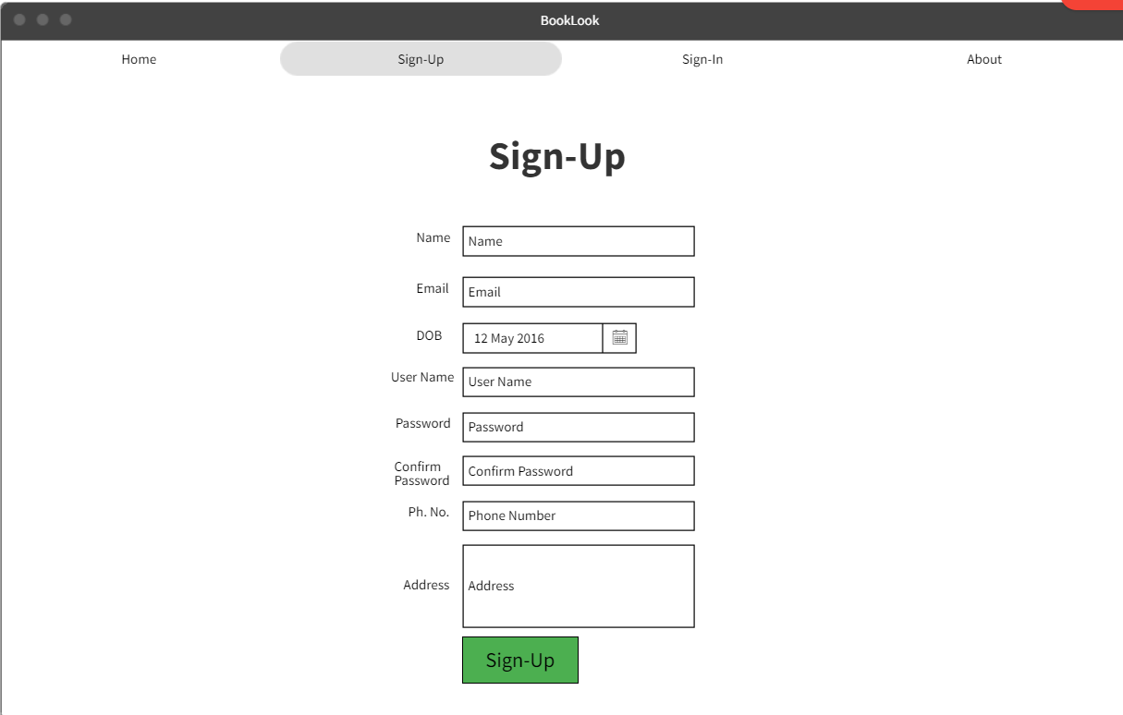
SIGN-UP PAGE

Slide 27
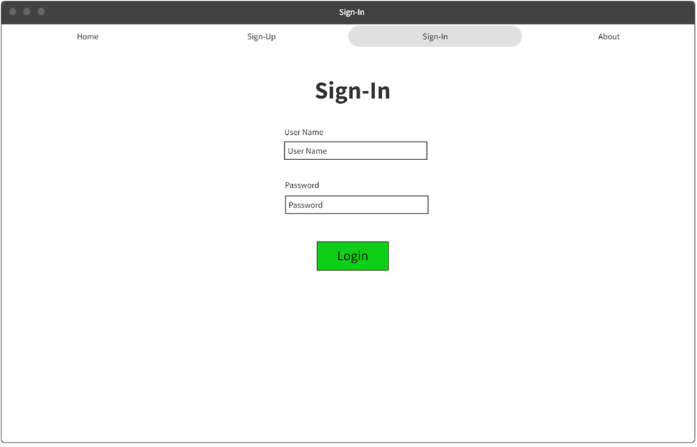
SIGN-IN PAGE

Slide 28
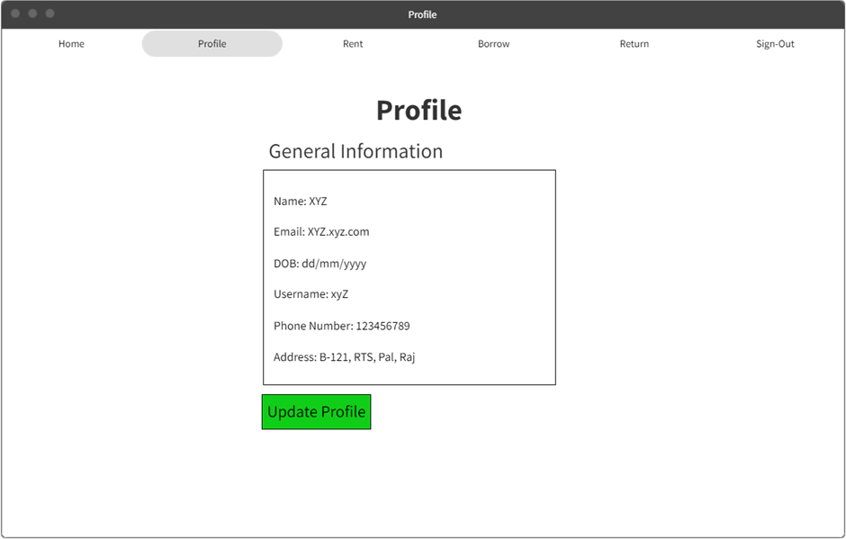
PROFILE PAGE

Slide 29
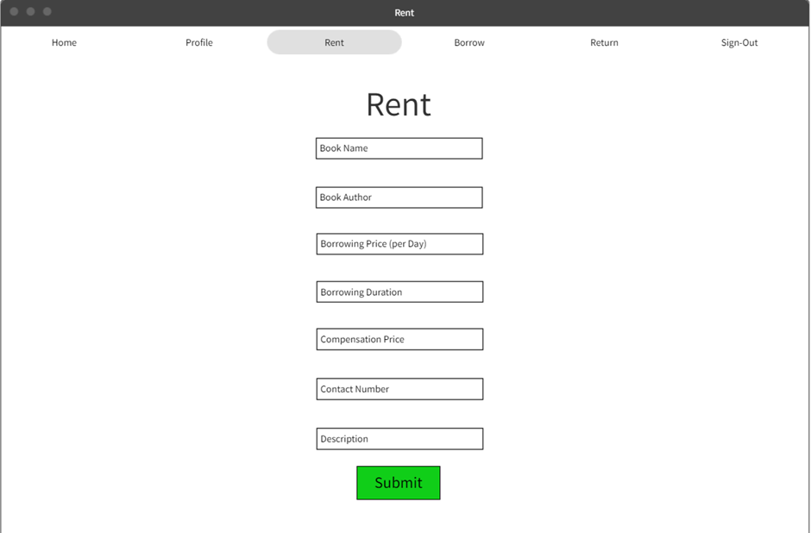
RENT PAGE

Slide 30
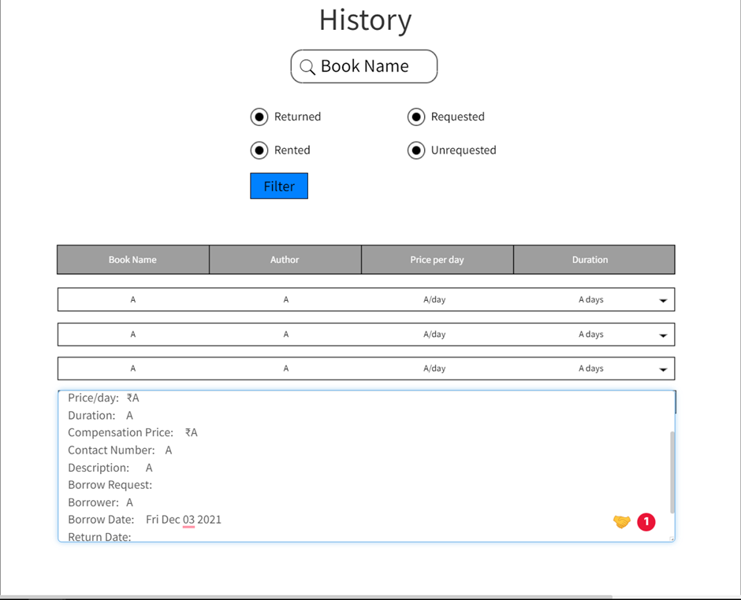
RENT HISTORY PAGE

Slide 31
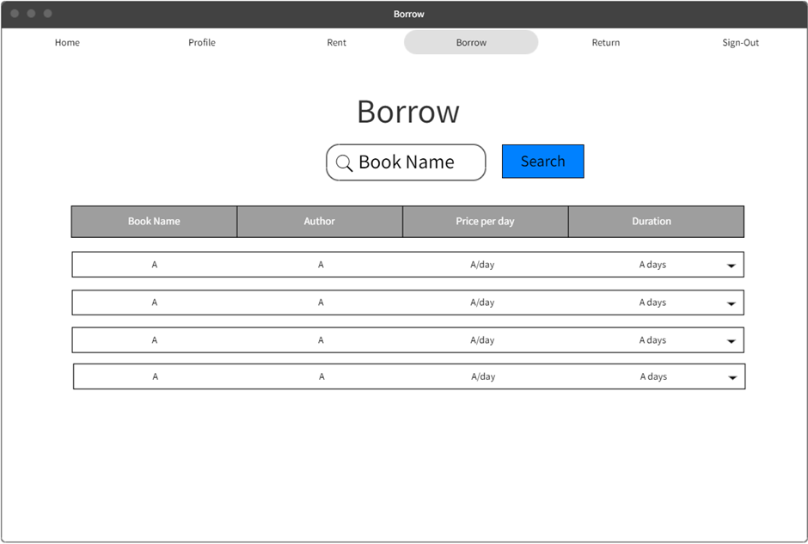
BORROW PAGE

Slide 32
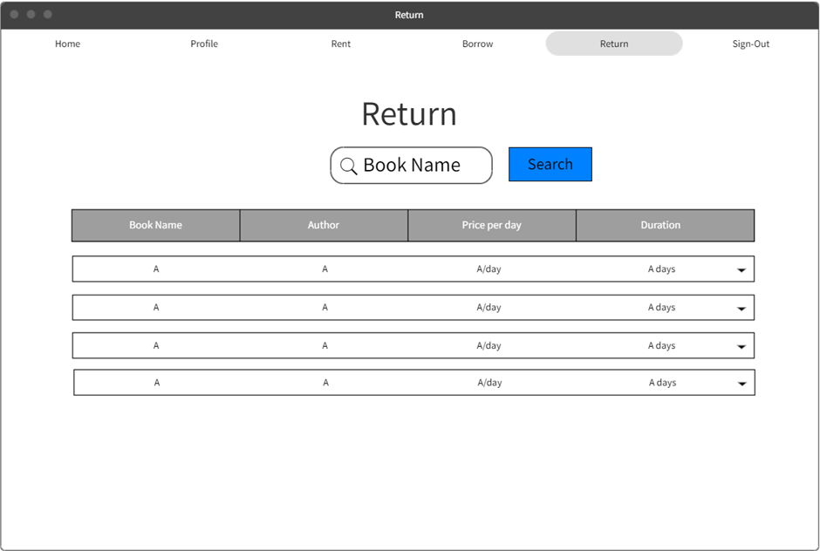
RETURN PAGE

Slide 33
SUMMARY
Book Look is an online web application where the customer can rent books online. Through a web browser, the customers can search for a book by its title or author, in general by this project one can rent the book from anywhere at any time. The convenience of an online book rental is a major consideration for most of us, especially those living in areas where access to a large bookstore is limited or is quite far away. Many books are too much expensive and for these types of books, this system is most preferable. If a book is too expensive, then one can rent that Book for some amount and can read that book by spending a very small amount of money.

Slide 34
After reading the whole book they can return a book and another one can take Benefit of this type of expensive books. Also, Textbook rentals are great for when you only need the textbook for a small section of the course. In such cases, purchasing a book just for one chapter could be a waste of money. So overall by this system one can read the book of their choice at any time by spending a very small amount of money. Using our platform both parties problems will get solved. The person which is possessing any book will get some sort of rent price so he will get benefited and the person who wants to read the book can get a book at a much less price and should return that book as per the norms and conditions decided.
. The user can also give feedback on the condition of the book and convey its overall renting experience by giving ratings on a score of five and can add beneficial comments so that the buyers get to know the genuine sellers. This also prevents the buyers from fraud and hence creating the best experience.

